Slide 1

SECURE CLIENT SERVER CHAT APPLICATION
Submitted By:
Ashish Pandey (500063104) Mridul Thapa (500060077)
Nikhil Mishra (500062584) Surabhi Kumari (500063663)

Slide 2
Problem Statement
In The client-server communication model the client applications running on devices are insecure and exposed to security threats. The main weakness of client-server chat application is that there is no security provided to data which is transferred between clients.
Objectives
The purpose of this project is to develop a chat application where by instant messages are encrypted with a private key at the transmission end, and decrypted with the same private key at the receiving end on the network using RSA Algorithm.

Slide 3
Encryption and Decryption
Encryption is a process of translating a plain text into something that appears to be random and meaningless and is difficult to decipher.
Decryption is a process of transforming encrypted information back into original data.
It’s Need
Provides security of data at all times.
Maintains integrity
Ensures privacy
Protects data across devices

Slide 4
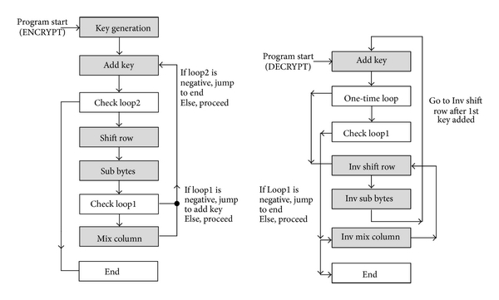
Use case of Encryption/Decryption
End to End encryption
Virtual private networks (VPN)
Secure Web Browsing

Slide 5
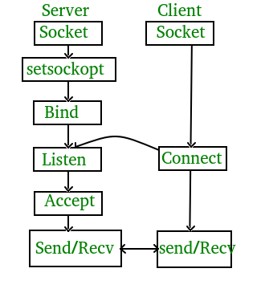
Socket Programming
Socket programming is a way of connecting two nodes on a network to communicate with each other. One socket(node) listens on a particular port at an IP, while other socket reaches out to the other to form a connection.

Slide 6
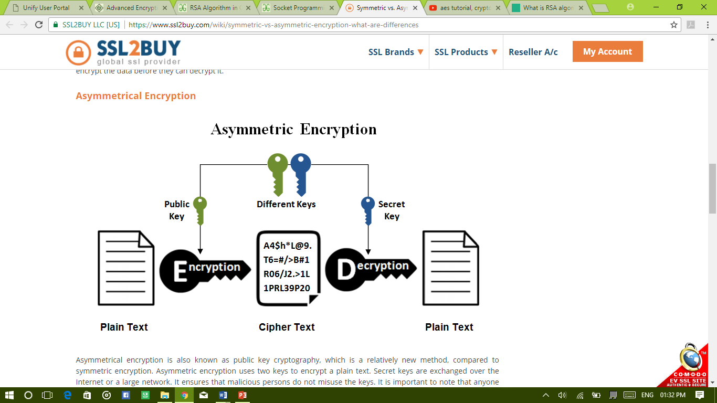
Algorithms used
RSA(Rivest–Shamir–Adleman) Algorithm:
RSA is the standard asymmetric algorithm, It uses two keys for encryption. The public key is open and the client uses it to encrypt a random session key. Anyone intercepts the encrypted key must use the second key, the private key, to decrypt it.

Slide 7
Project Workflow
Phase 1:
Choosing Data Type
Methodology:
Step 1: Connect two users using Socket programming.
Step 2: Communication between a Client and Server.
Step 3: Securing the chat application using RSA Algorithm.
Phase 2:
Data Compression
Phase 3:
Data Encryption
Phase 4:
Data Decryption
Phase 5:
Data Decompression

Slide 8
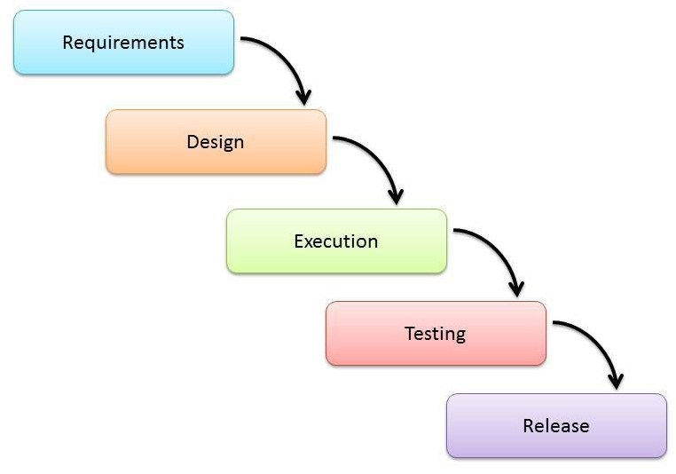
SDLC Model Used:
Waterfall Model

Slide 9
Pert Chart
Using RSA algorithm to compress different types of data checking for lossy/lossless.
Requirement Analysis
First week of September
September 2019
August 2019
Project Starts
Starting Encryption on Compressed Data. Working On decryption part.
First week of September
Gathering information and starting off with compression using RSA algorithm.
first week of October
Decrypting the data using the public key at the receivers end
Last week of October

Slide 10
OUTCOMES
To build up a dependable and encrypted system programming network chat application between client and server
To provide a secure chat room in case of any internet breakdown.
To provide a secure fast channel for faster transmission of data.
Use of Asymmetric encryption methods to secure both ends of the communication channel.

Slide 11


